Slide 1
ANNUAL Title I Meeting
Title I, Part A Federal Program
Student Achievement
Parent and Family Engagement
College and Career Readiness
Professional Development
Support Services

Slide 2
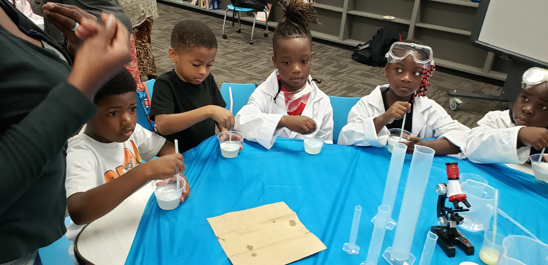
Title I Overview
What is Title I?
Title I Funds
Title I Plan
Parent Family Engagement Plan
School/Parent/Student Compact
Parent’s Right to Know
School Improvement Plan
Needs Assessment/Budget

Slide 3
What Is Title I ?
Title I, Part A, is a federal grant that provides resources to help children gain a high-quality education and the skills to master the Florida Standards.
Title I provides additional resources to schools with high concentrations of economically disadvantaged students. These resources may include additional teachers, professional development, tutoring, parent involvement activities, and other activities designed to raise student achievement.
For public schools, Leon County Schools implements a schoolwide model.

Slide 4
Title I Funds
Title I funds are used to provide services that are supplemental or, in addition to, services normally provided by the school district for participating children.

Slide 5
Title I Plan
The Title I Plan allows schools to consider federal, state, and local funds when planning their school’s educational program and budget. Schools utilize the school-wide Title I model to implement a high quality program resulting in increased academic achievement.
Annually, schools are required to review their plans and evaluate the effectiveness of strategies and resources implemented to meet academic goals.

Slide 6
Parent/Family Engagement Plan
Schools develop and implement annual Parent and Family Engagement Plans to support student achievement. Parents are asked to partner with school teams as planners, participants, and decision-makers in the operation of the school-wide Title I program. This partnership is vital in strengthening the program’s ability to meet the needs of all students and support parents’ active commitment to their student’s learning and development in school.

Slide 7
School-Parent-Student Compact
The School-Parent-Student Compact is an agreement between the parent, teacher, and the student. Students have an increased opportunity for success when expectations are clear, consistent, and supported at home. Effective schools are a result of families and educators working together. We encourage you to form a partnership with your school.

Slide 8
School Improvement Plan
The purpose of a School Improvement Plan is to guide the school’s problem-solving and planning process throughout the school year.
The School Improvement Plan helps to identify, organize, and implement strategies and resources that will lead to increased student achievement.
A copy of the School Improvement Plan can be found in the school’s front office and on the school’s website.

Slide 9
Parent’s Right to Know
Parent’s Right to Know - Parents have the right to request information regarding the professional qualifications of their child’s teacher’s. Complete the form provided by your school to request this information.

Slide 10
Title I needs assessment
Each school summarizes its needs assessment within their Title I Plan.

Slide 11
Budget overview
Each school receives an allocation to support student achievement, parent engagement, and college and career readiness.
How is the money utilized (examples-not a comprehensive list):
Tutoring
Additional teachers to reduce class size
Academic Coaches
Academic Interventionist
Student Software
Professional Development

Slide 12
Title I Documents
The Parent and Family Engagement Plan, Right to Know Letter, School-Parent-Student Compact, and Title I Plan
Most documents are posted to the school’s website.
Document review may be requested at your school site (request per school).
Information related to these documents will be presented at each school’s Annual Title I Meeting.

Slide 13
All parents are encouraged to participate in parent and family engagement activities. Check your school and district calendars for upcoming events!
Engage. Enrich. Empower

